Slide 1
Analyze Data on List Pages
Public preview
Business Central
2023 release wave 1

Slide 2
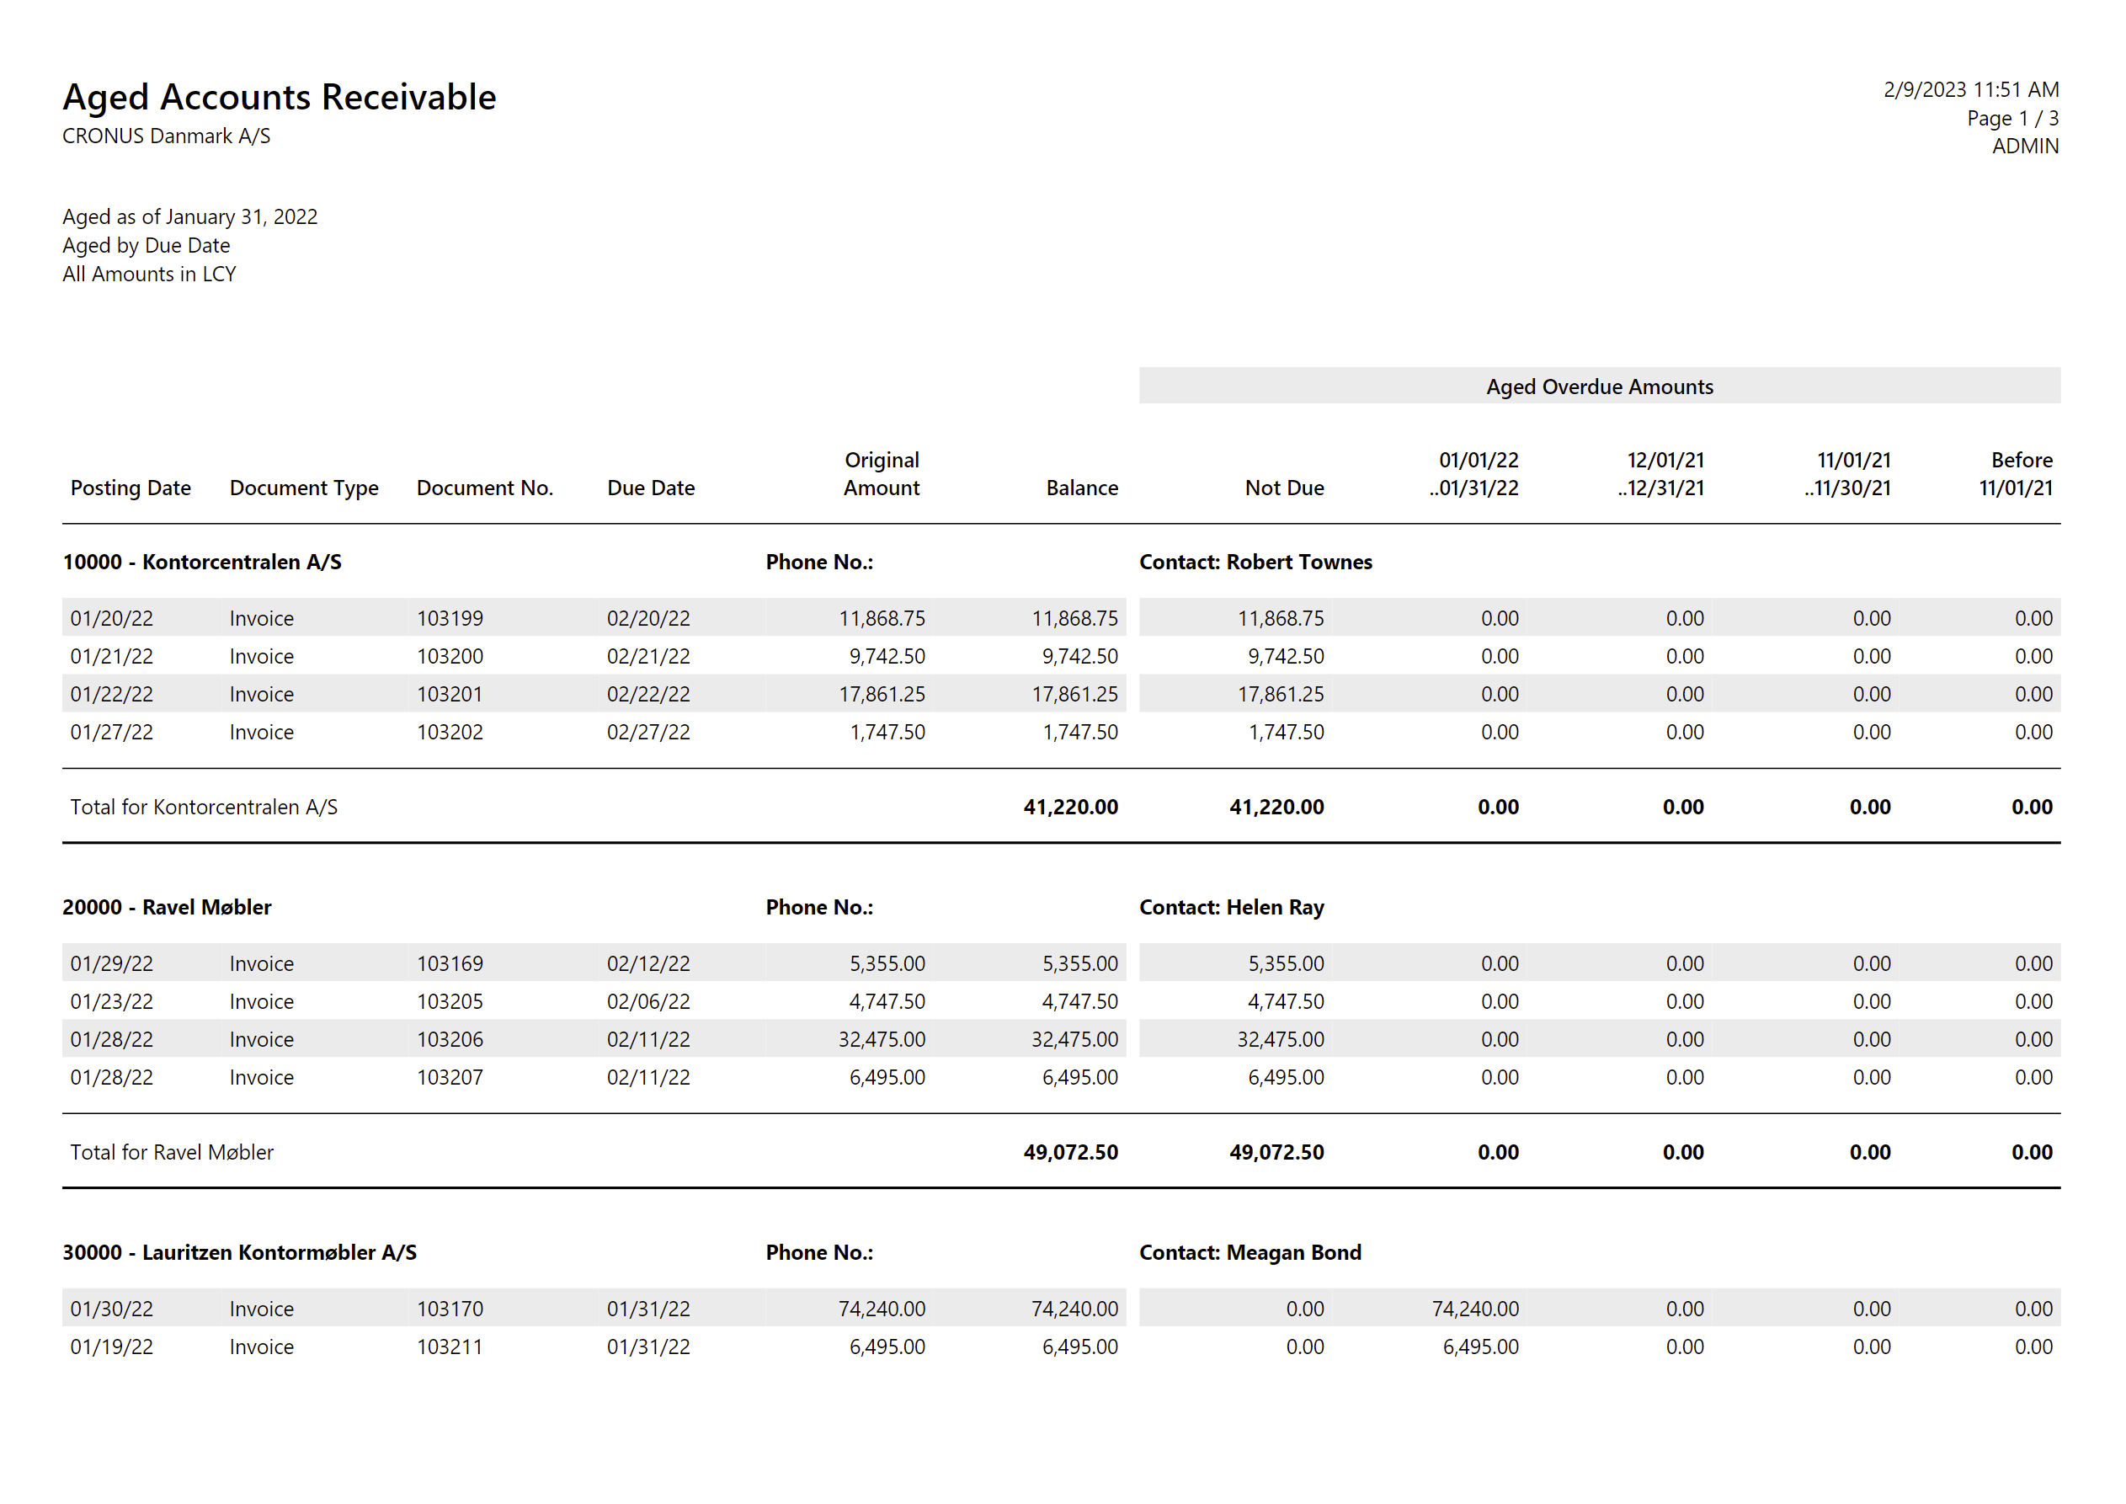
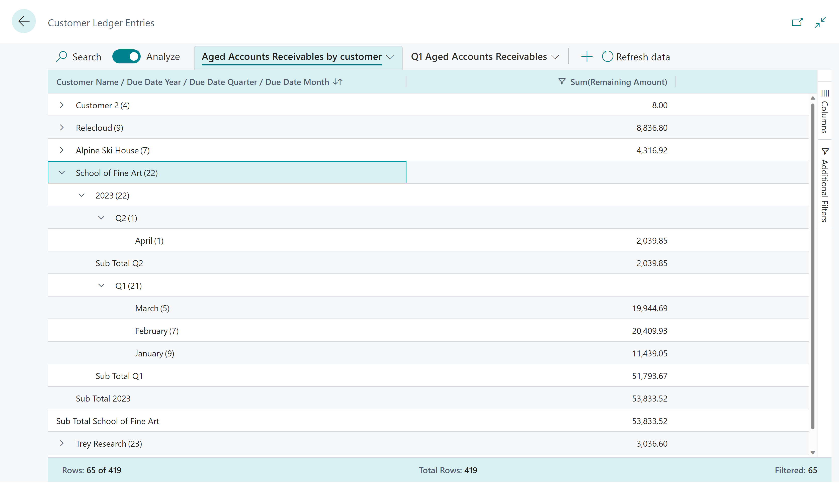
Analyse Data on List Pages is…
Before (run a report, get a PDF)
Now (self-service data analysis)

Slide 3
With Analyse Data on List Pages, you can
Quickly extract insights from your data directly in Business Central with no need to involve developers.
Design data your way: For each analysis,
Pick columns, reorder them, freeze left/right
Set additional data filters
Group and pivot
Mark cells and do some quick fact checking
Copy some/all data, import to Excel/PowerPoint/…
Save your analysis for repetitive use.

Slide 4
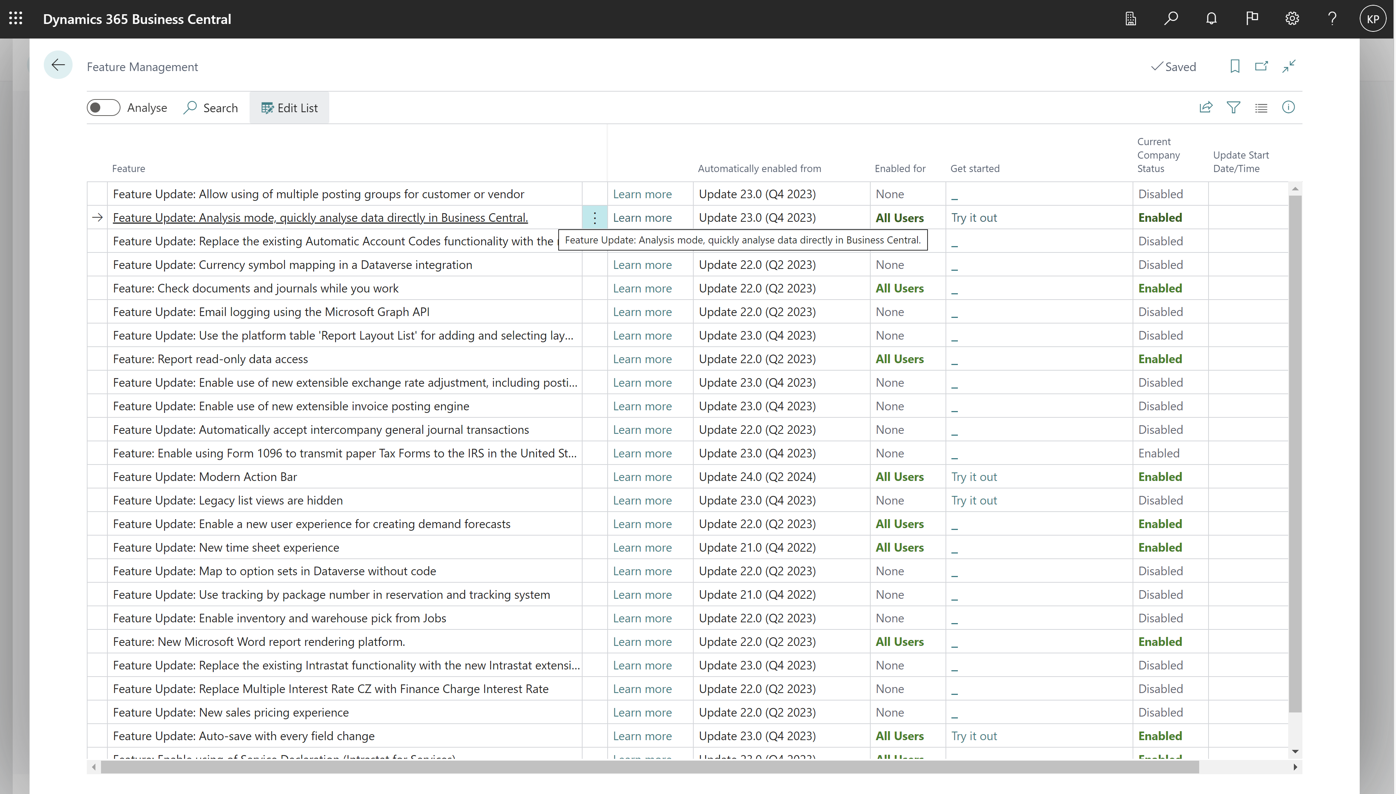
Enable under Feature Management (2023 release wave 1)

Slide 5
In 2023 release wave 2 (GA)
Feature is enabled for all users (no need to use Feature Management)
Feature can be turned off
on pages (by the AL developer)
for a user (using a permission)
Users can share an analysis tab with a co-worker
get a share link

Slide 6
In 2023 release wave 2 (GA) (continued…)
Improvements to the UI
first time you enter analysis mode, analysis menus are open
users last choice of analysis menus (open/closed) are persisted per analysis tab
No limitations on data volume to analyze
If you analyze more than 100k rows, platform shifts to more efficient way to load data
Analyze data from query objects

Slide 7
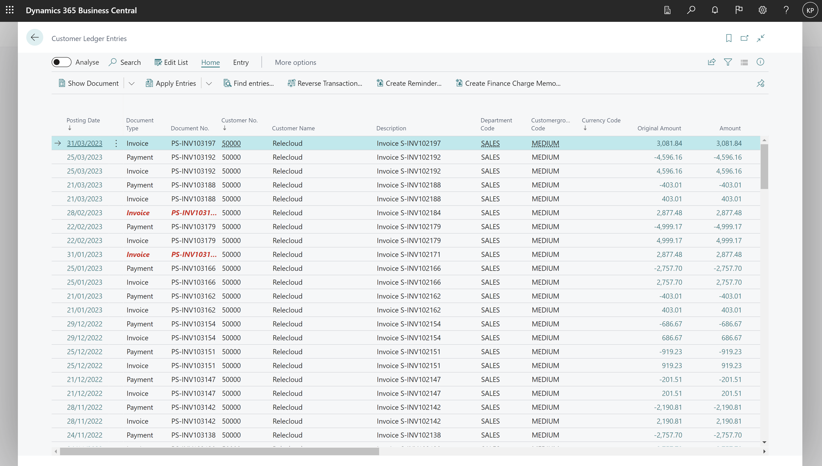
Go to Analysis Mode on a list page

Slide 8
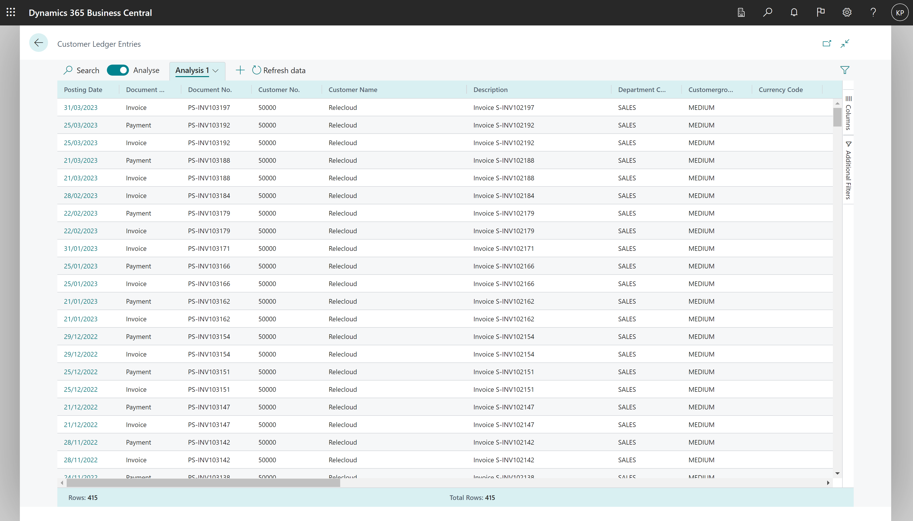
Opens the list with additional analysis capabilities

Slide 9
Page Areas in Analysis mode
Tabs pane
Field modifier area
Data area

Slide 10
Row count always shown on the bottom of the page

Slide 11
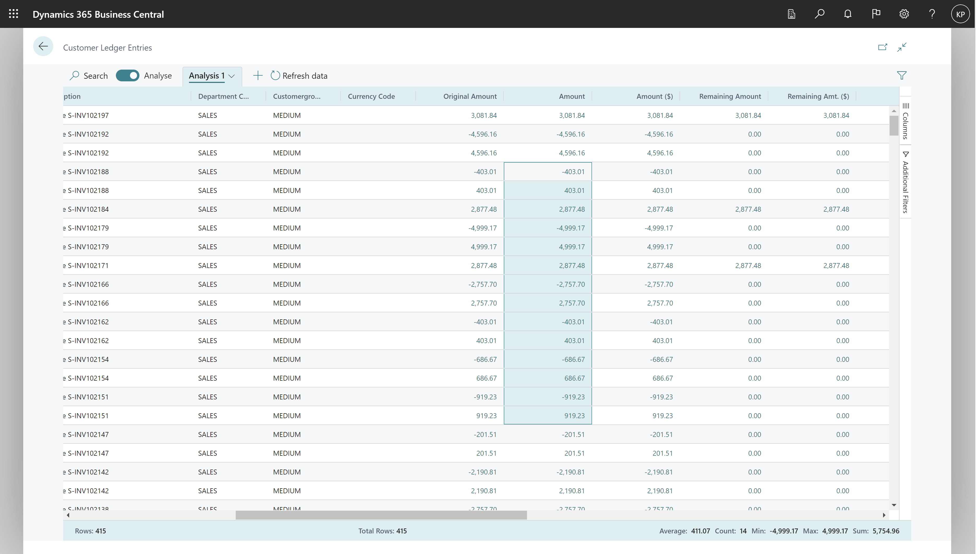
Mark cells for easy statistics

Slide 12
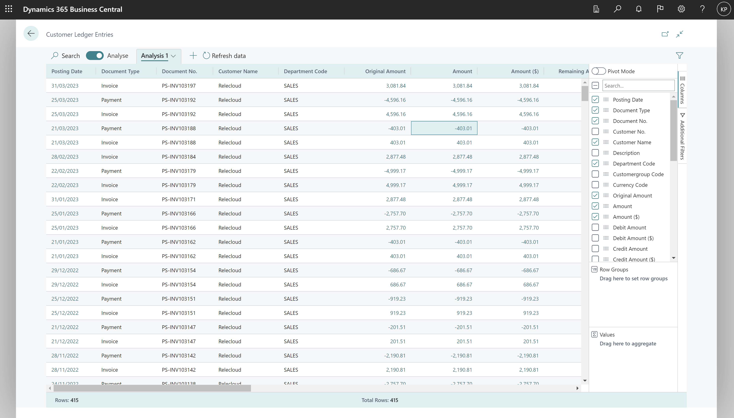
Choose which columns to show

Slide 13
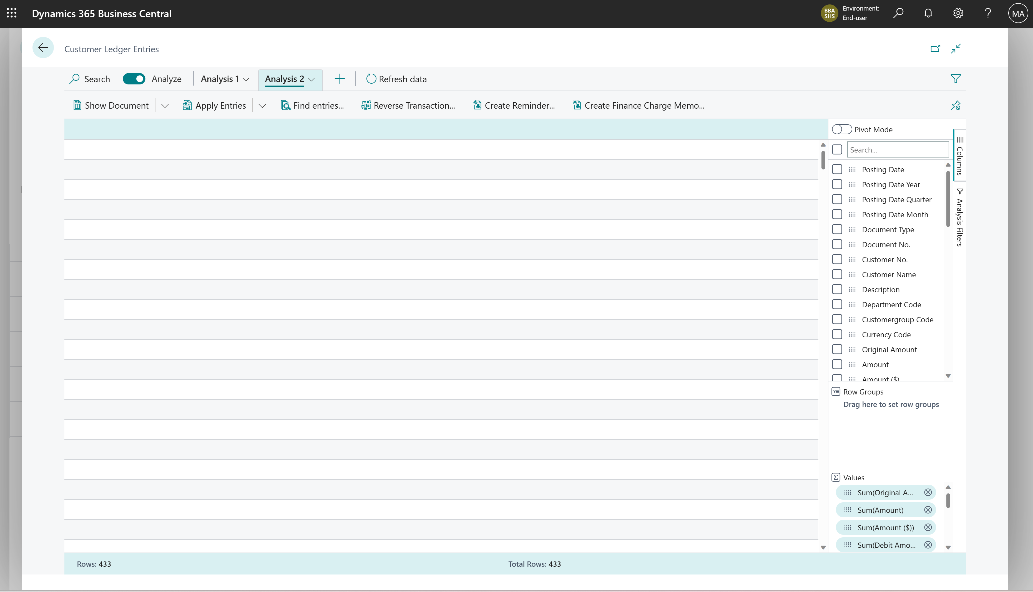
Clear all columns

Slide 14
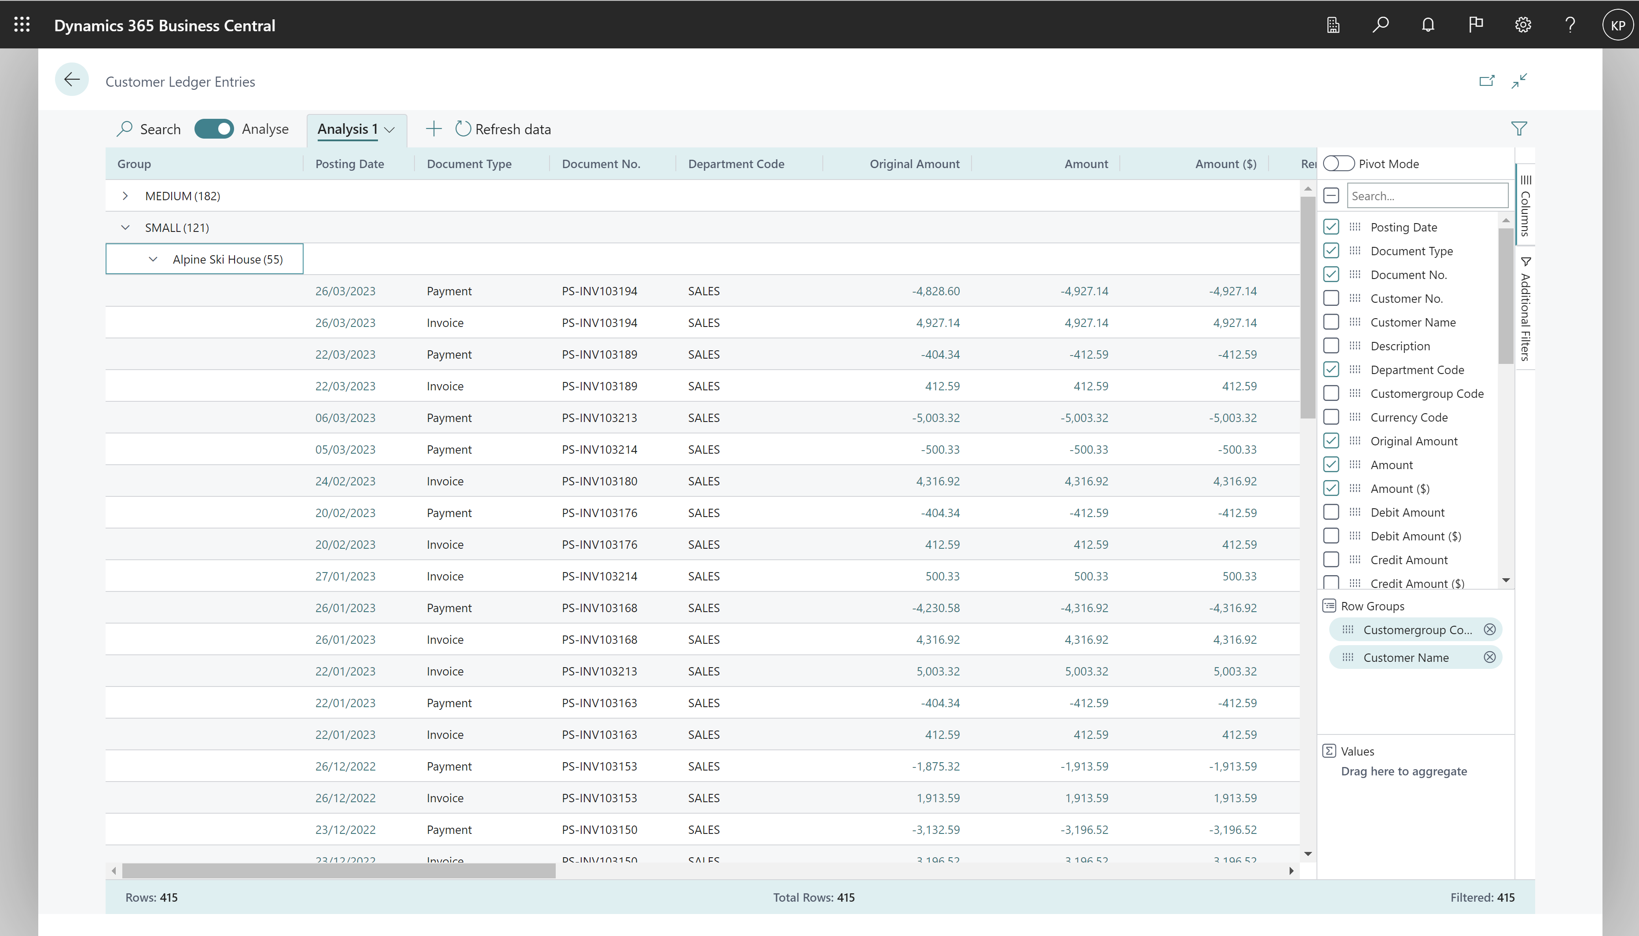
Group data by Row Groups

Slide 15
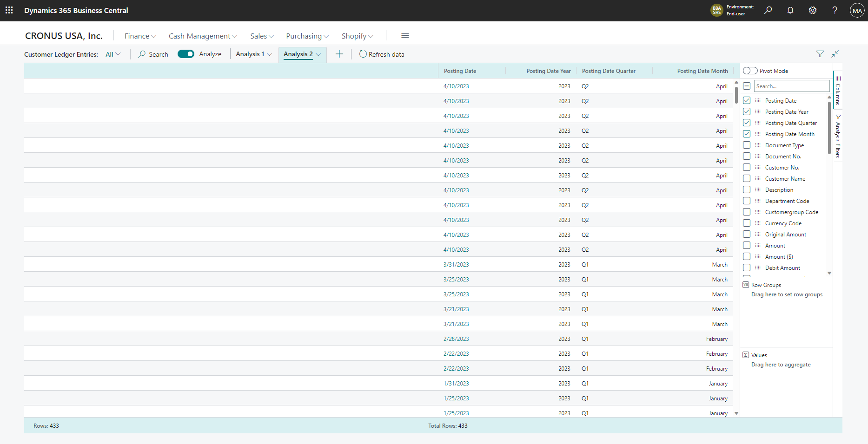
All date fields has a Year-Quarter-Month hierarchy

Slide 16
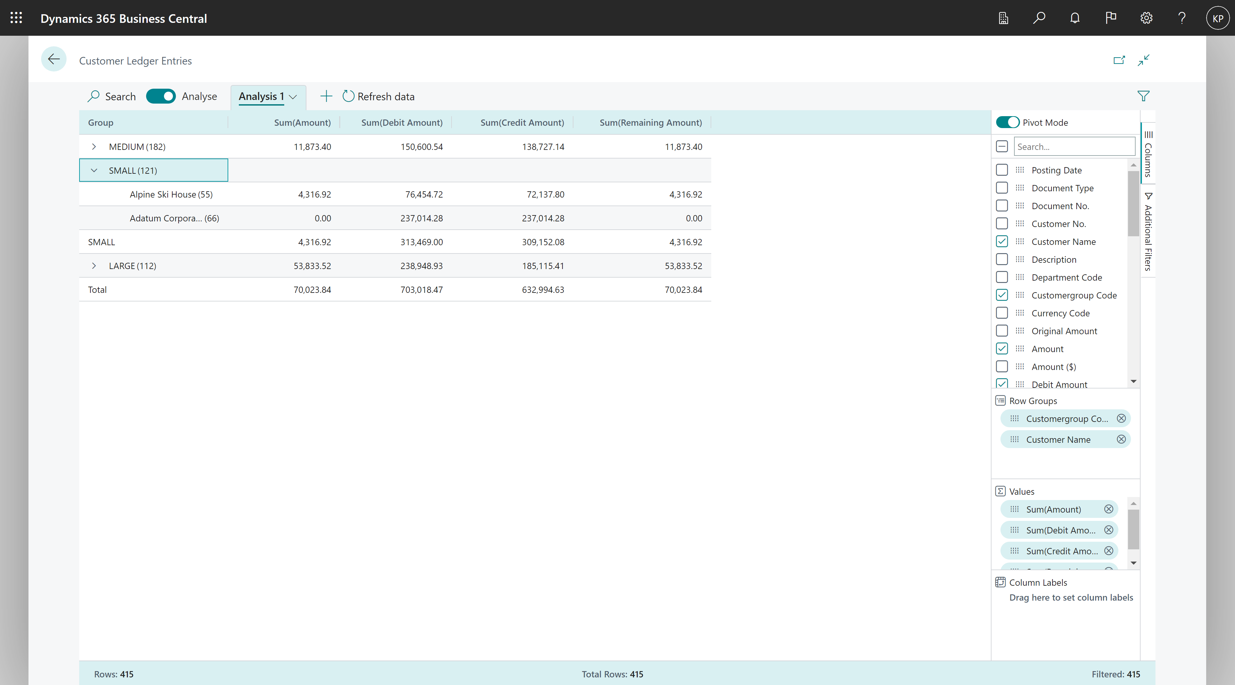
Pivot data by Row Groups

Slide 17
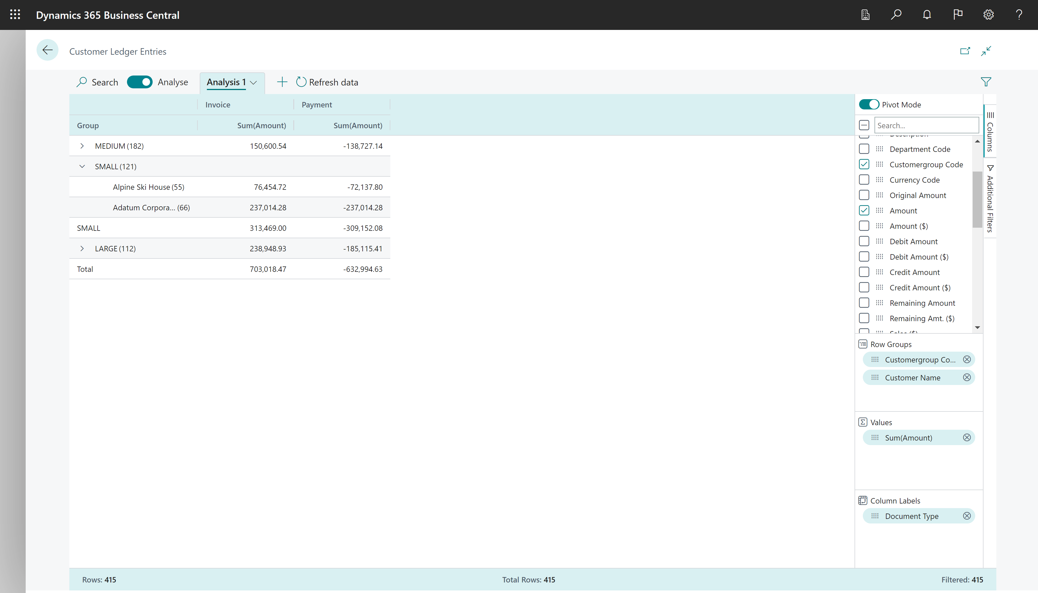
Pivot data by Row Groups and Column Labels

Slide 18
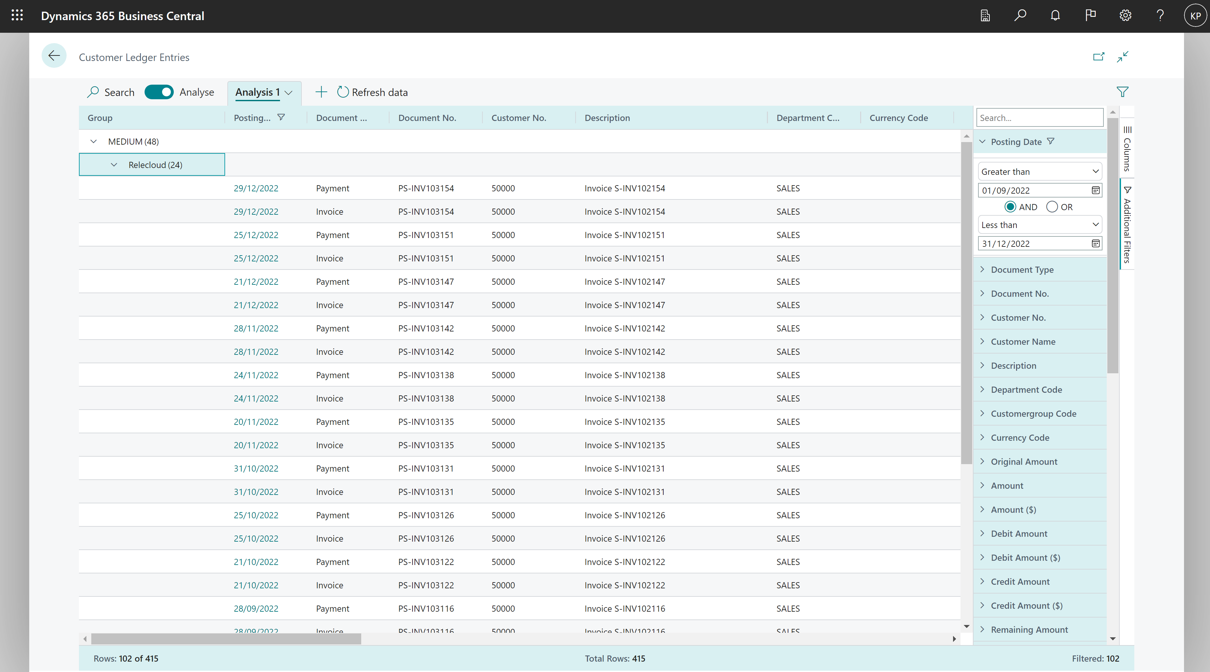
Set additional filters (local to the active tab)

Slide 19
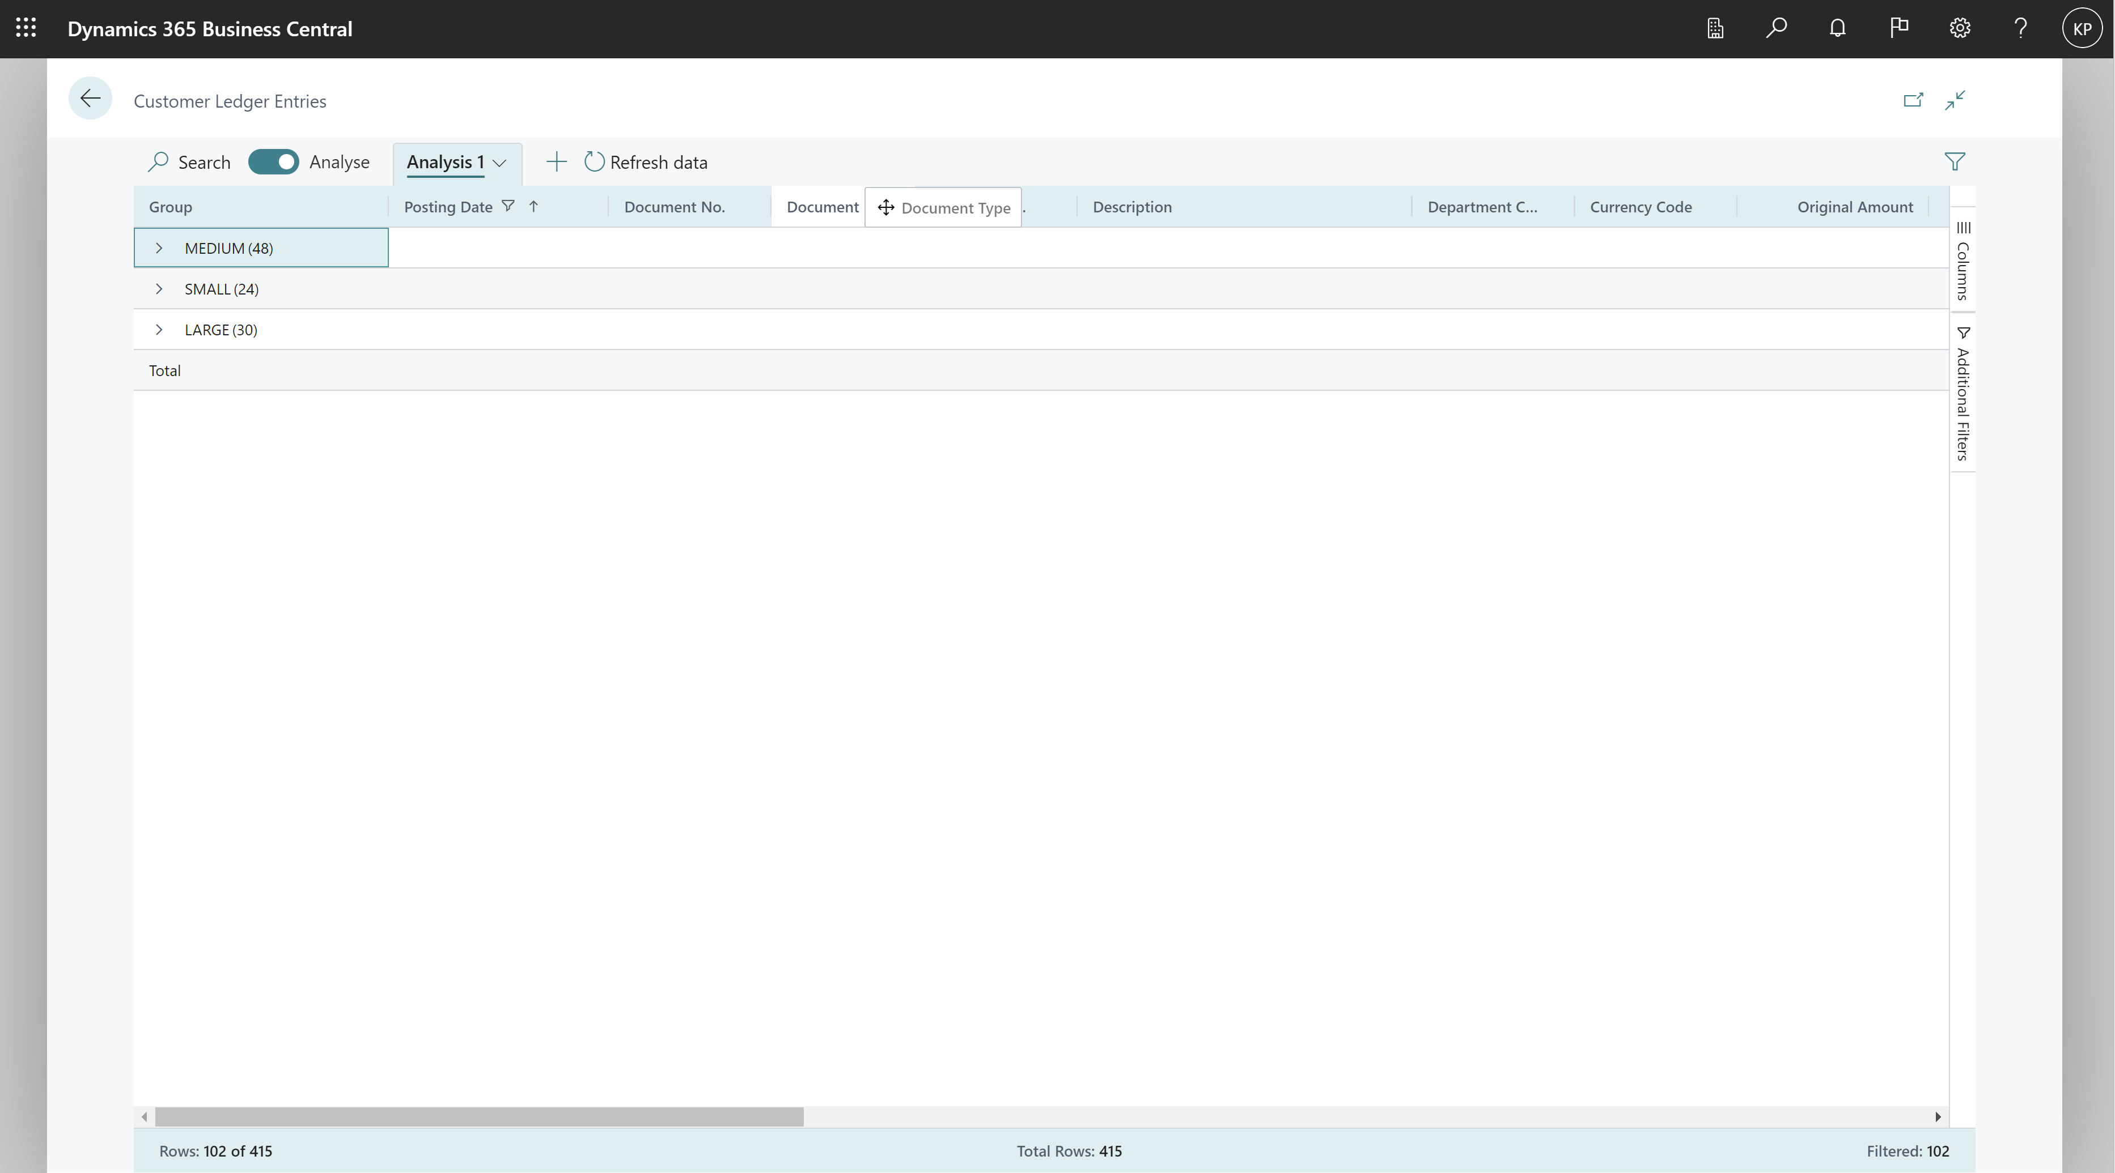
Drag and drop columns

Slide 20
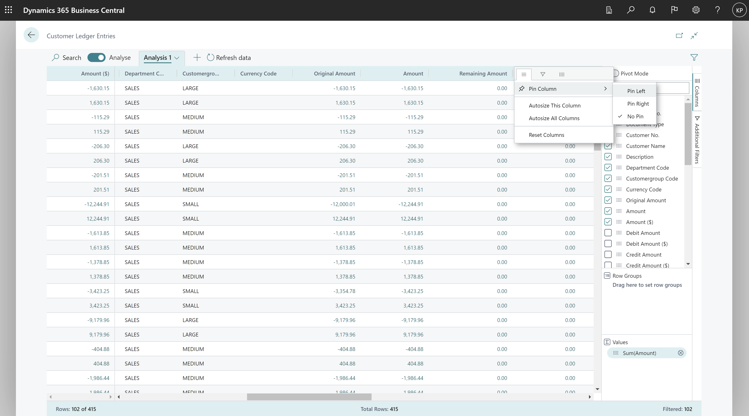
Pin columns (to left or right)

Slide 21
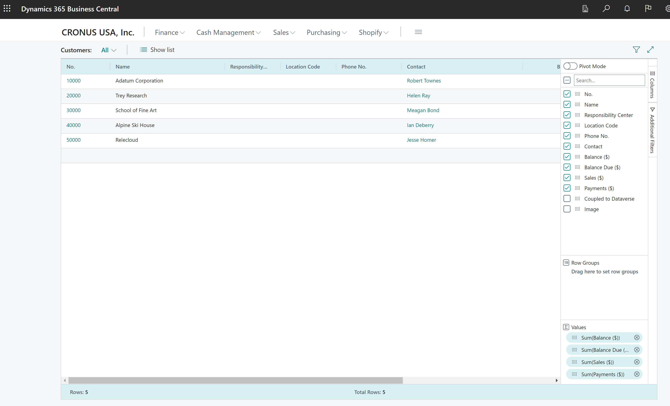
Peek to details or open card

Slide 22
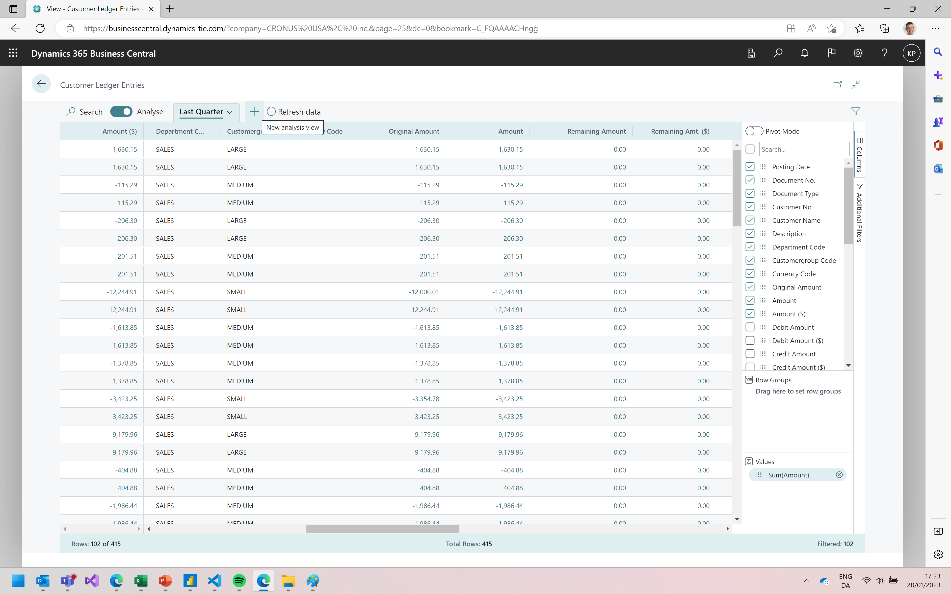
Add new tabs

Slide 23
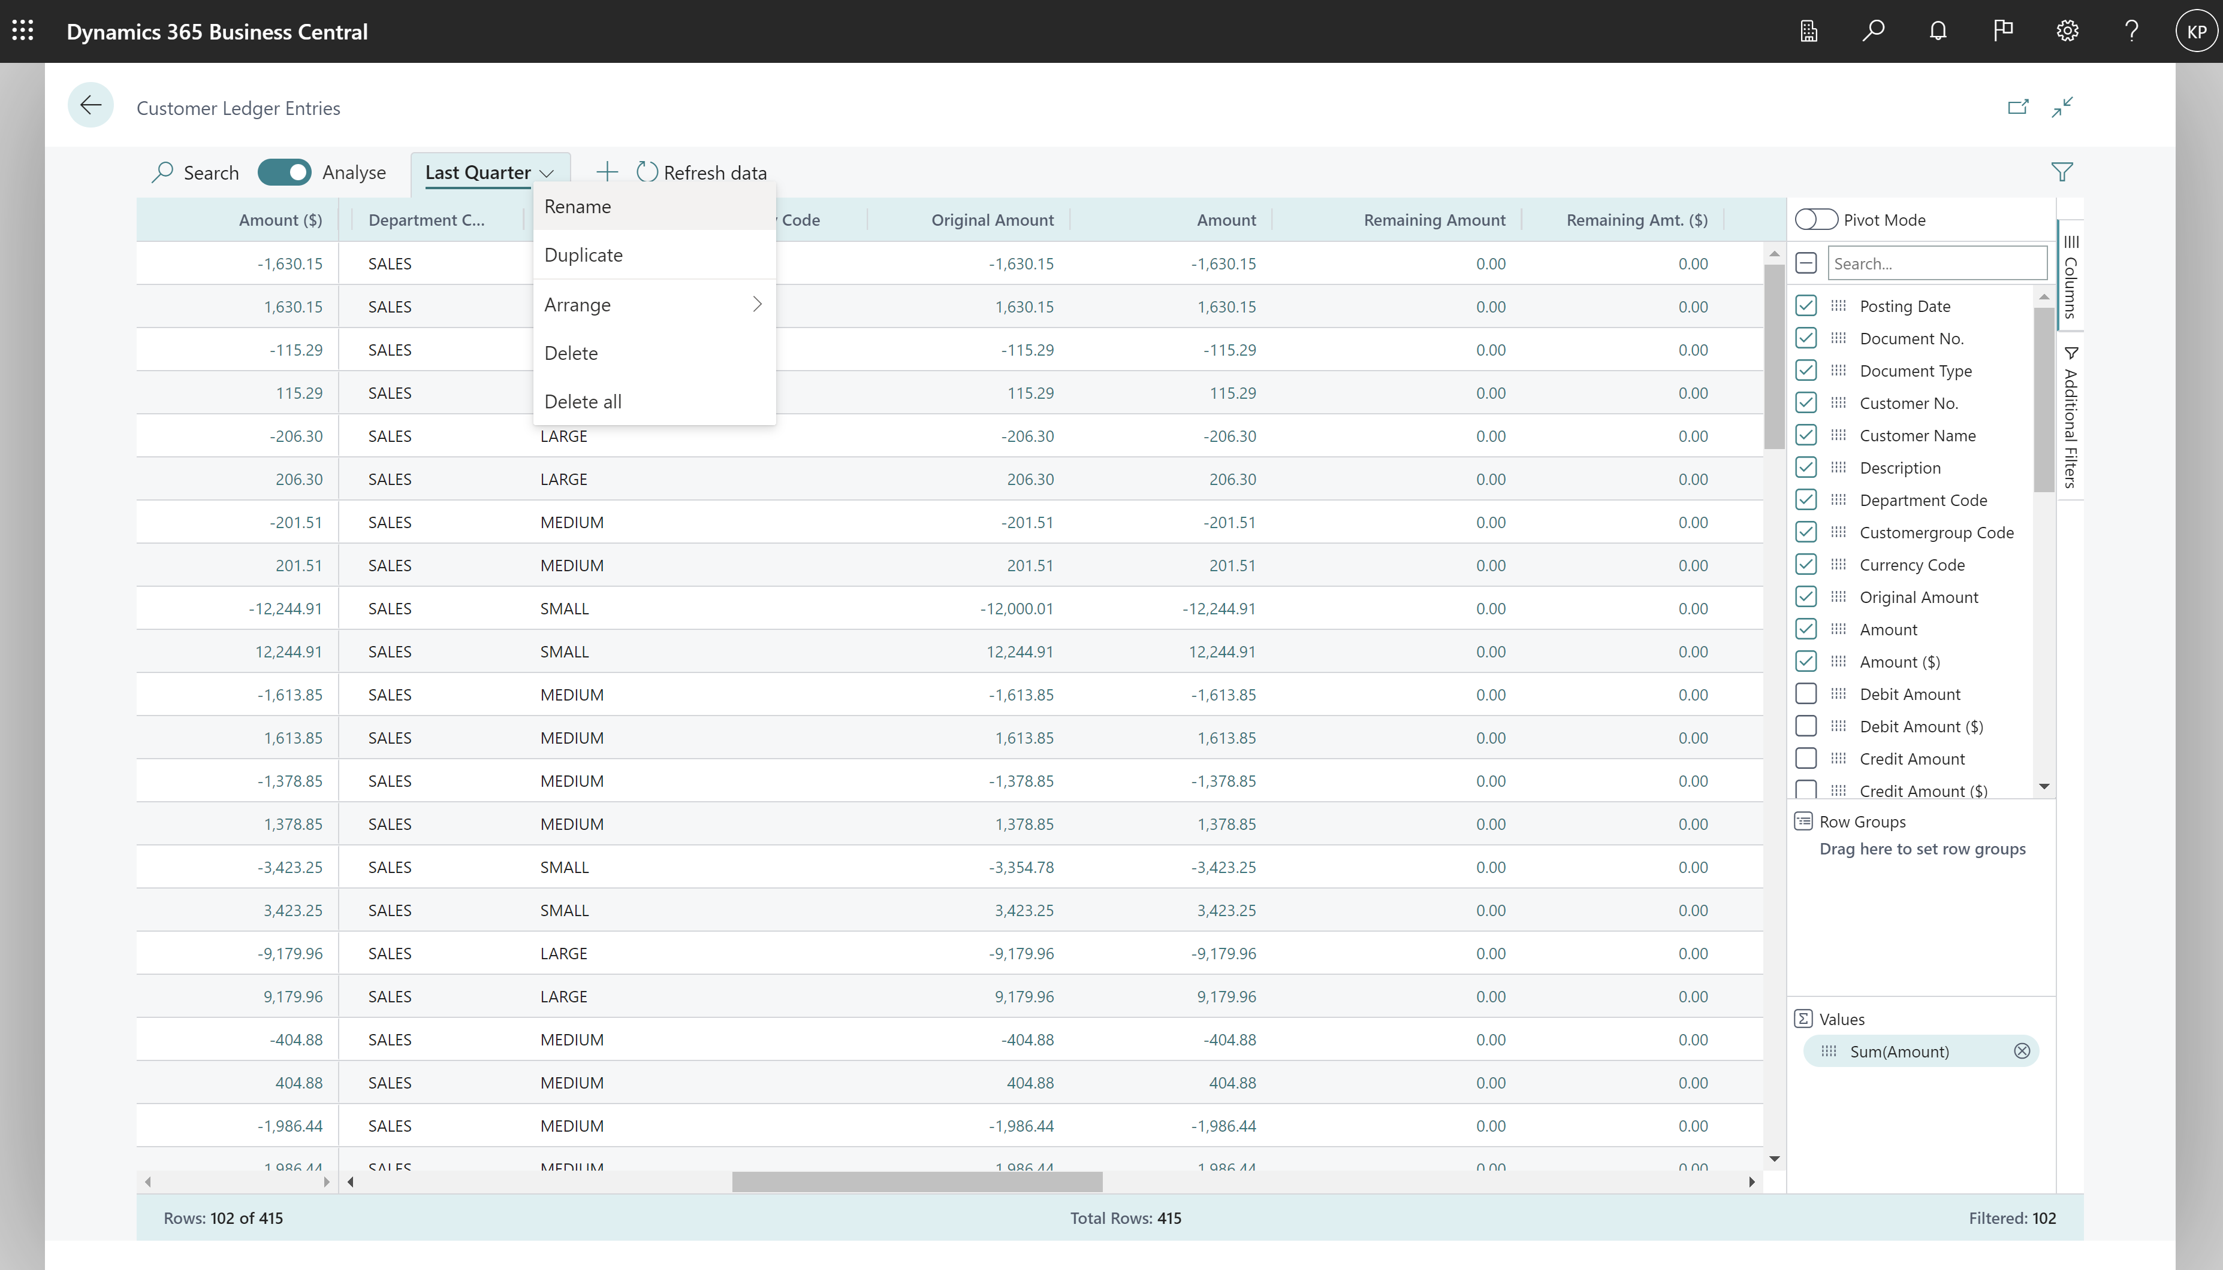
Rename (or copy or delete) tabs

Slide 24
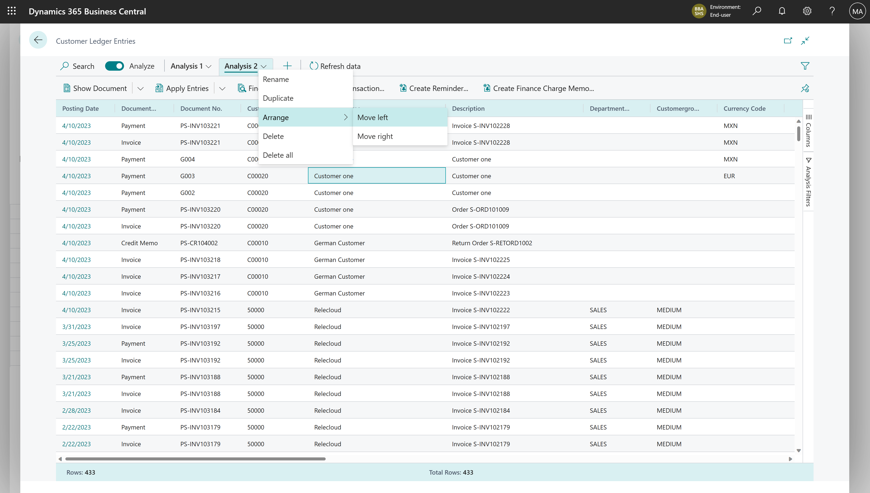
Arrange tabs

Slide 25
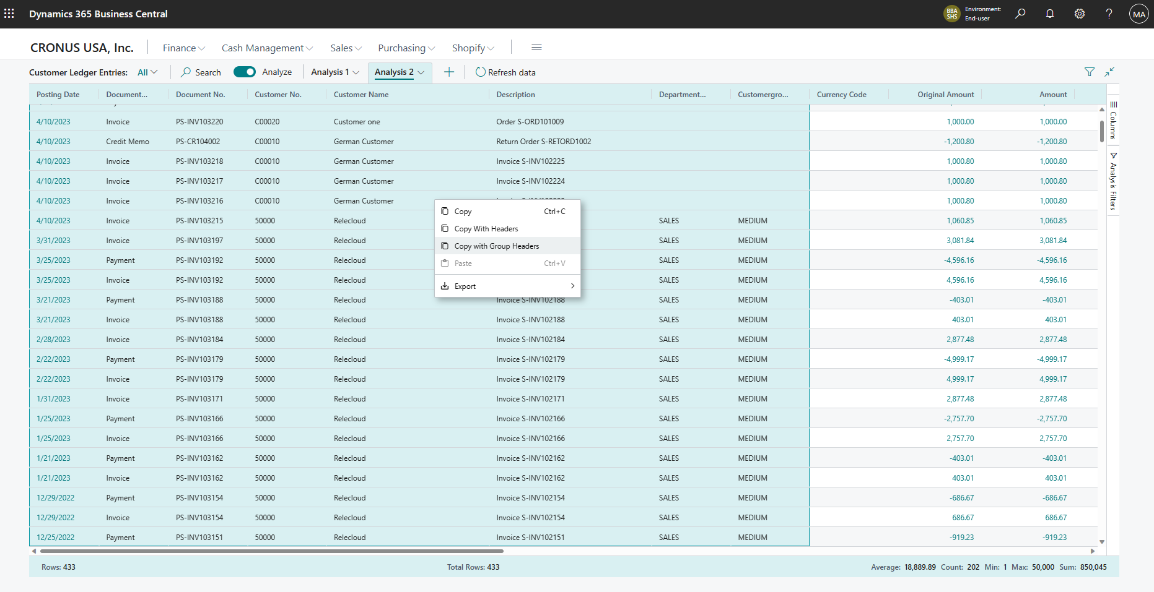
Mark data and copy (right-click on the data area)

Slide 26
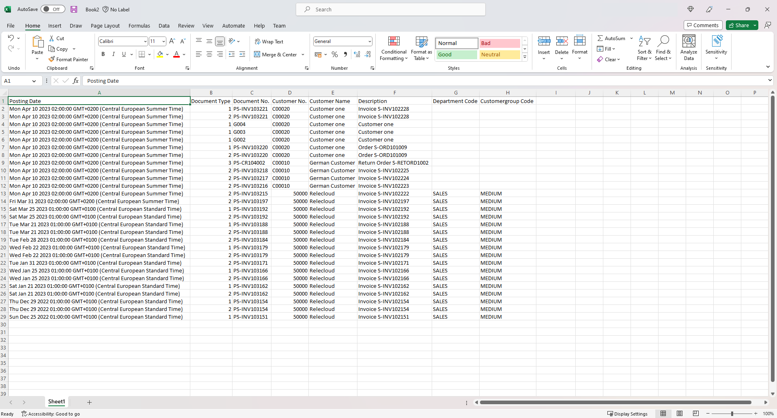
Mark data and copy (copy directly to Excel)

Slide 27
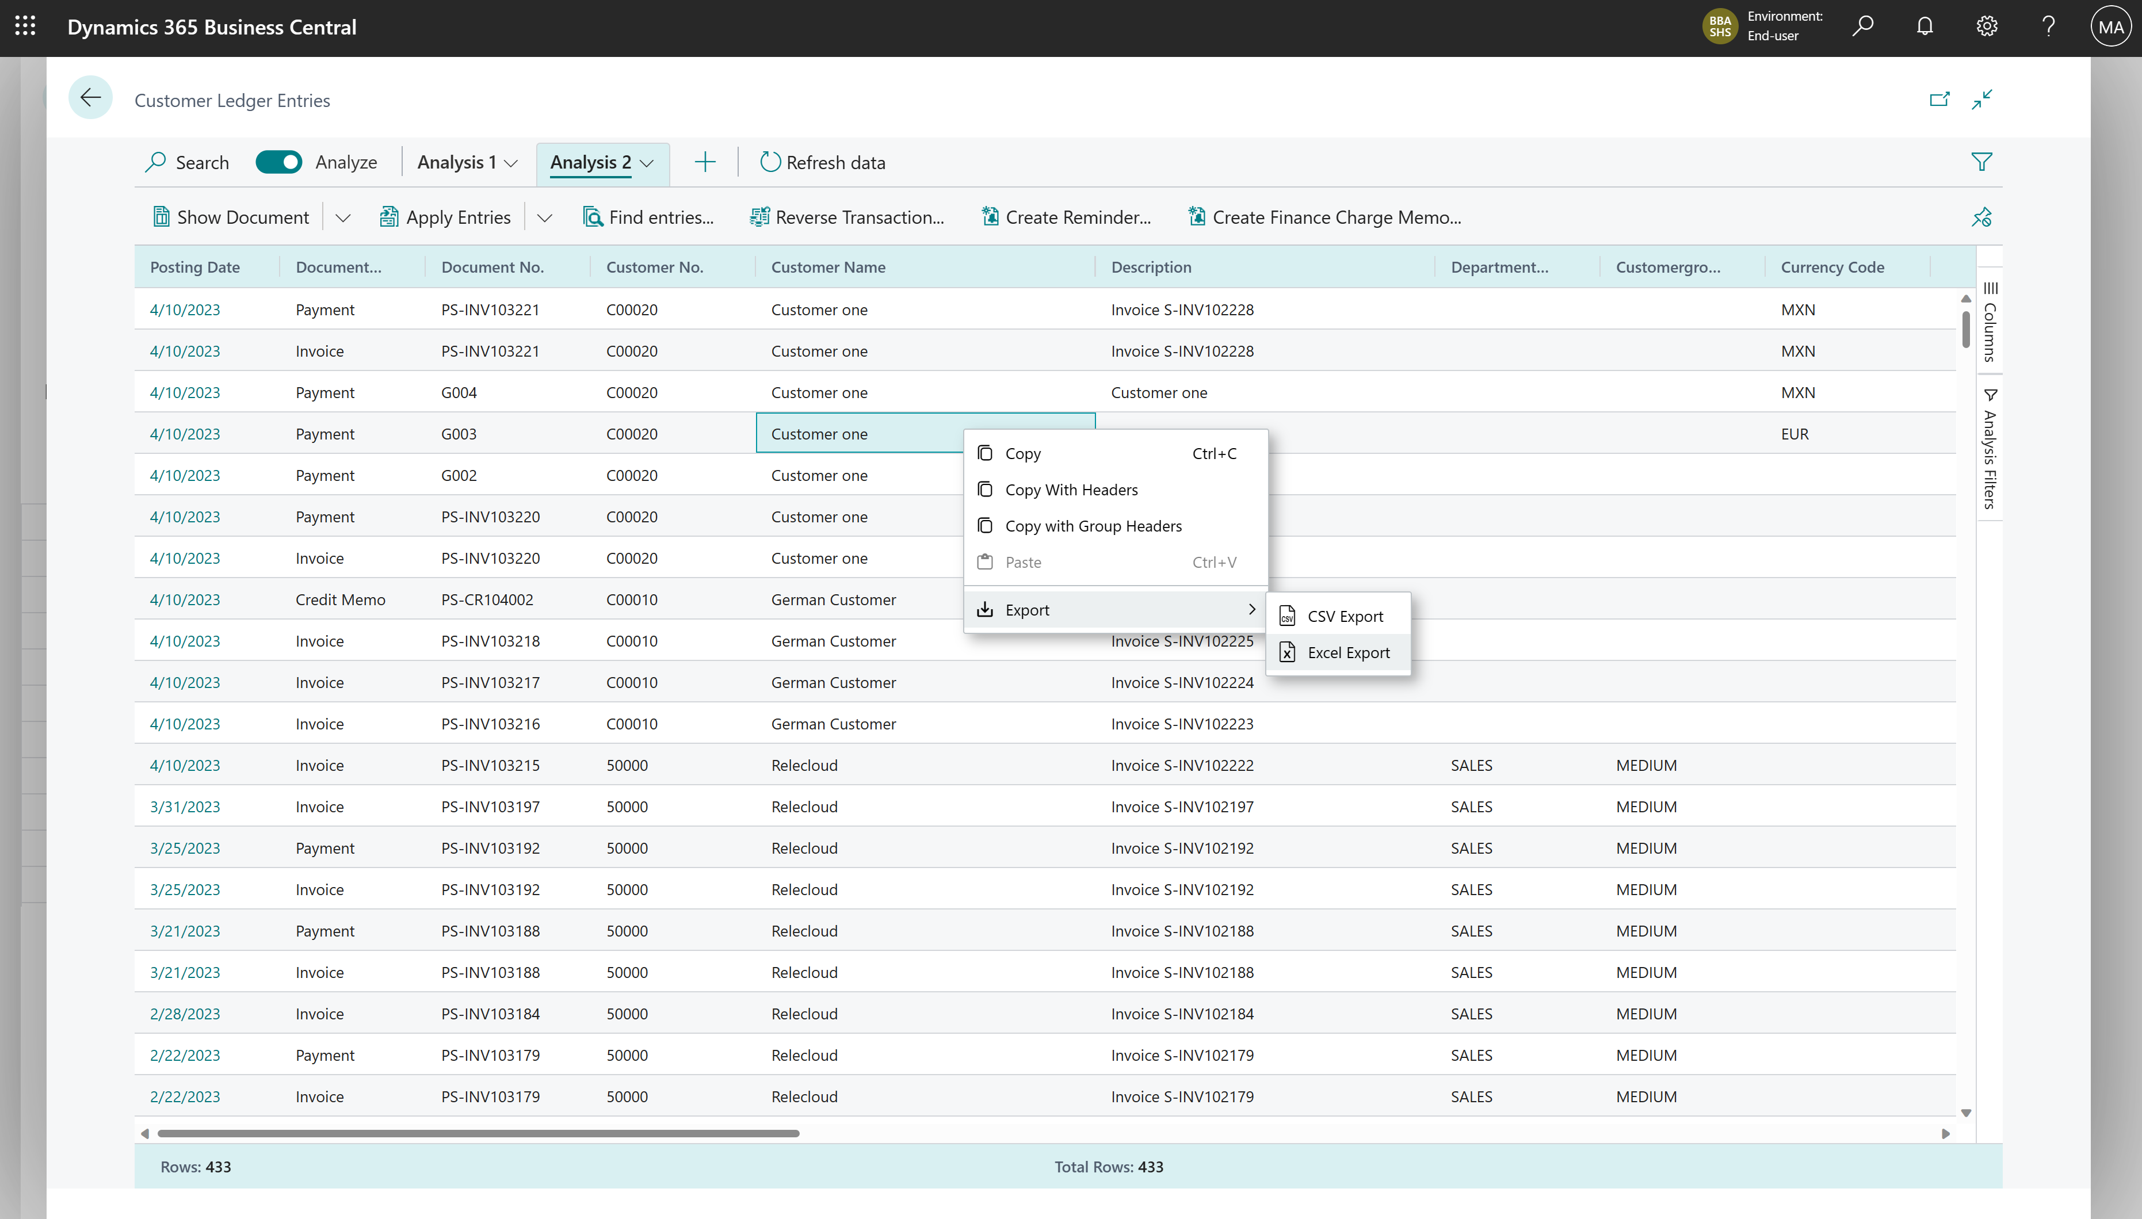
Export data (right-click on the data area)

Slide 28
Excited? We are!
Coming in public preview
Business Central
2023 release wave 1

